Slide 1
Flappy Bird Game
By:
Pavan Sidhu, Alina Shaikh, Rhea John, and Nathan Kantorov

Slide 2
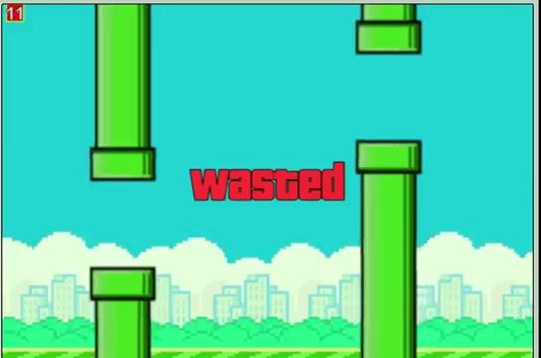
Original Game
Notes:
This is the originally game, it included a score which in recess every time you successfully pass through the pipes. It also had the background, the character, as well as sounds and everything else needed to function.

Slide 3
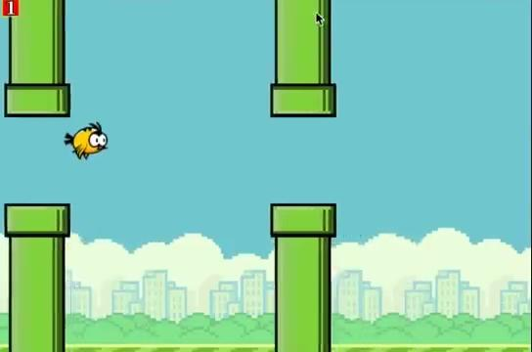
Final Version
Notes:
List of changes: Buttons, Instructions, Music, Increase jump height, Death music changed,
Started on skins but didnt time finish due to time constraints

Slide 4
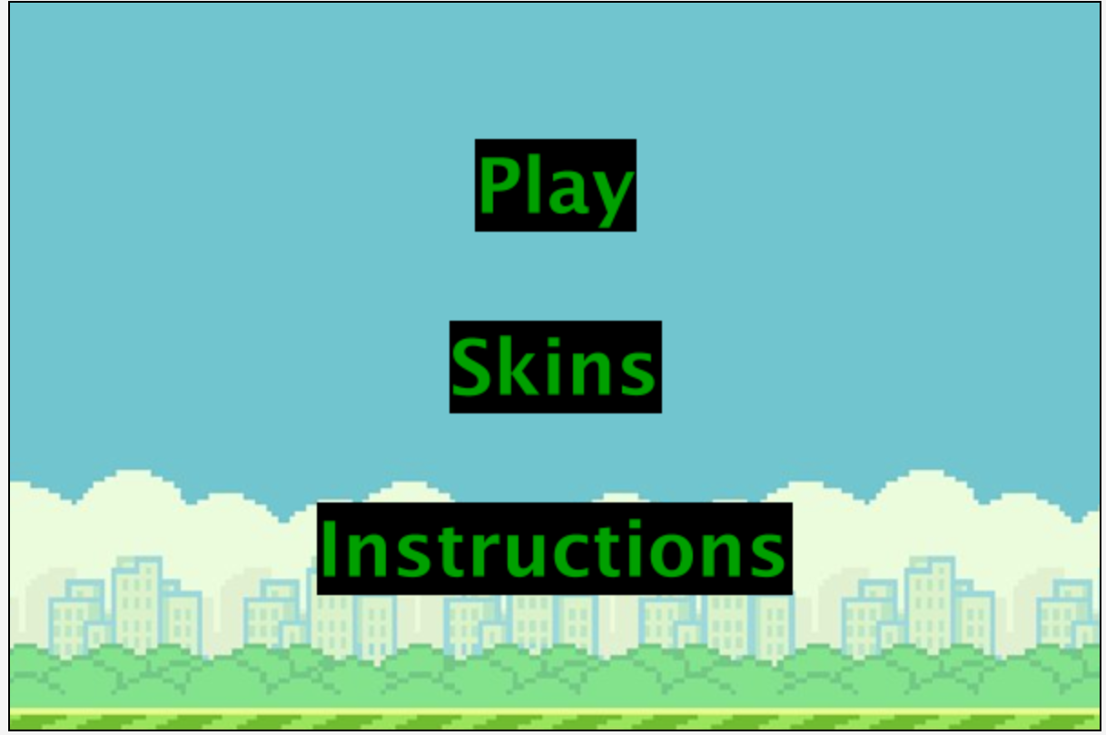
Notes:
This is the home screen. The play button starts the game. The skins button takes to the skins menu, and the instructions button takes you to the instructions screen

Slide 5
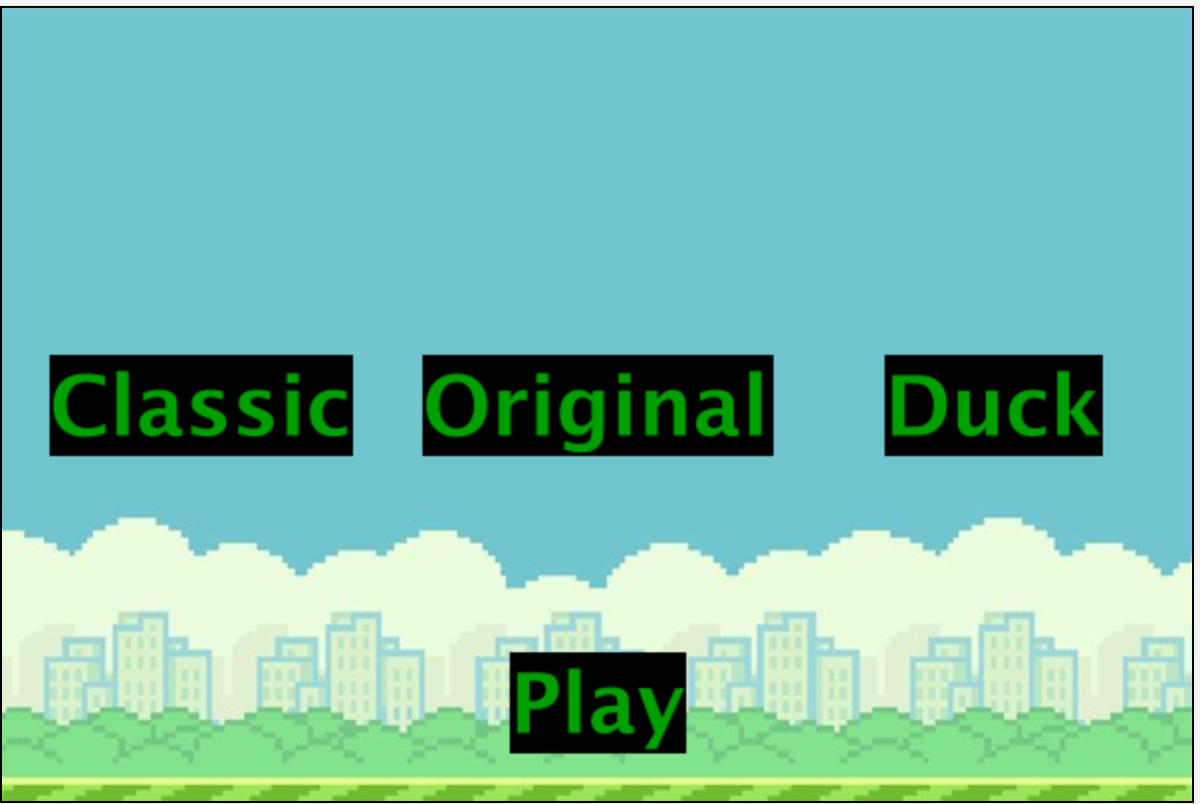
Notes:
This is a screenshot of the skins menu. This is where you could change how your character looked. Classic looks like the one from the old game, original is the one that was there when we downloaded the game. The play button should work, however the rest of it doesn’t, since, as previously mentioned, we couldn’t finish it due to time constraints.

Slide 6
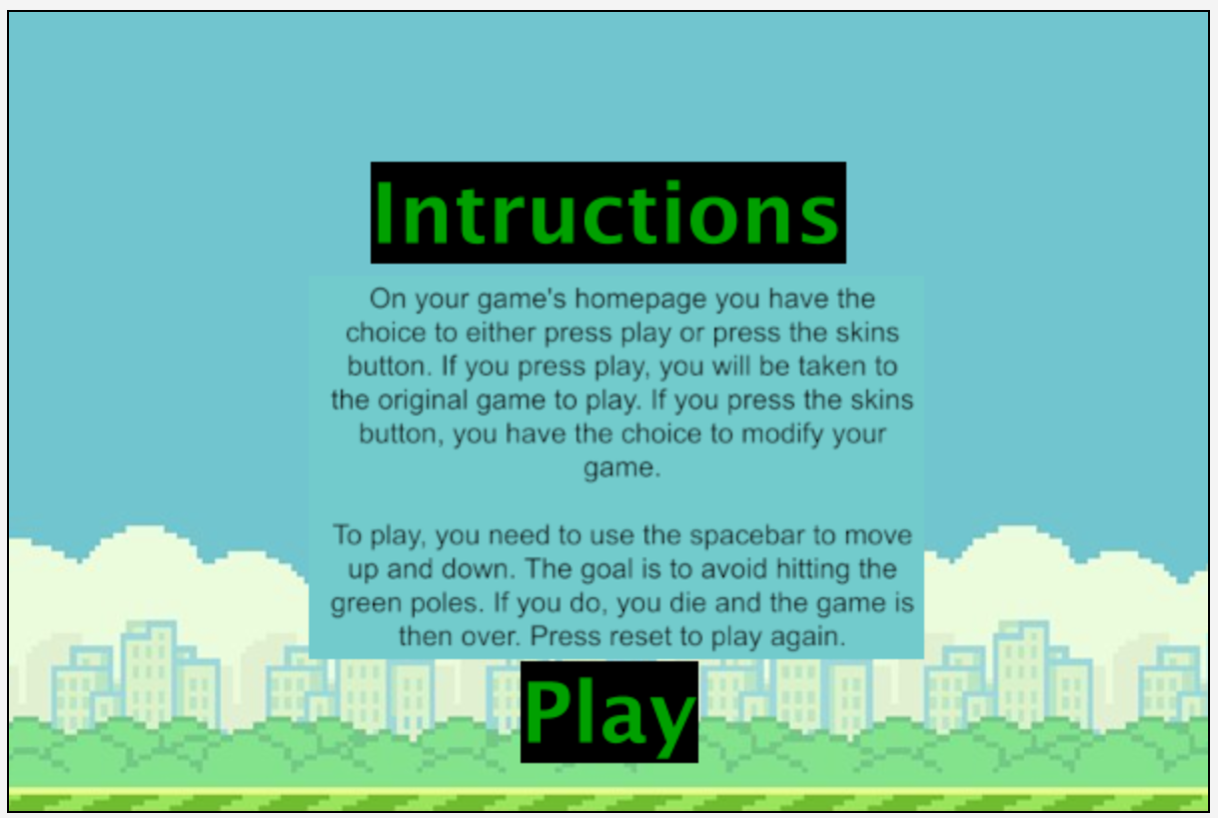
Notes:
This is the instructions page it goes to when you click the instructions button

Slide 7
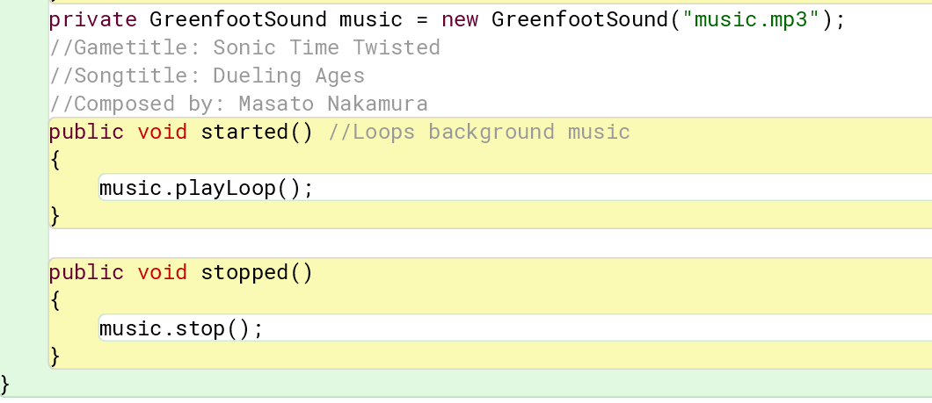
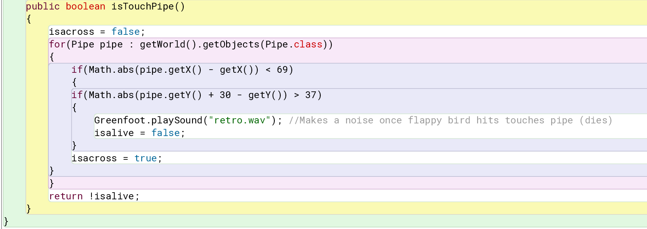
Loops
Infinite Loop
For Loop
Notes:
A loop is a single statement or a block of statements that can be repeated. Loops are used to repeat a statement or block of statements inside a pair of curly braces. We incorporated loops into this game by having the background music be an infinite loop, which is when the loop never ends.
A for loop is a loop that has a header with 3 optional parts: initialization, condition, and change. It does the initialization one time before the body of the loop executes, executes the body of the loop if the condition is true, and executes the change after the body of the loop executes before checking the condition again. In this case, the for loop checks whether or not Flappy Bird with pass through the pipes.

Slide 8
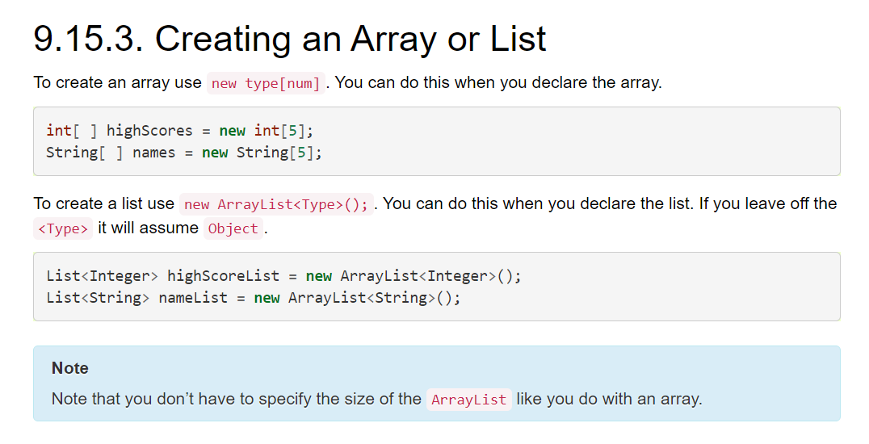
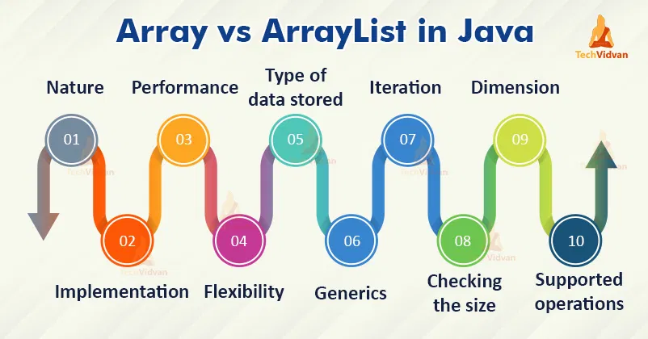
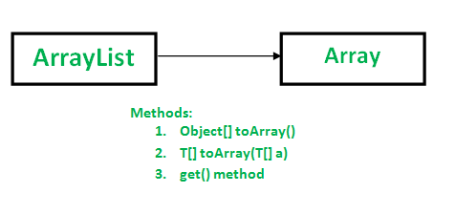
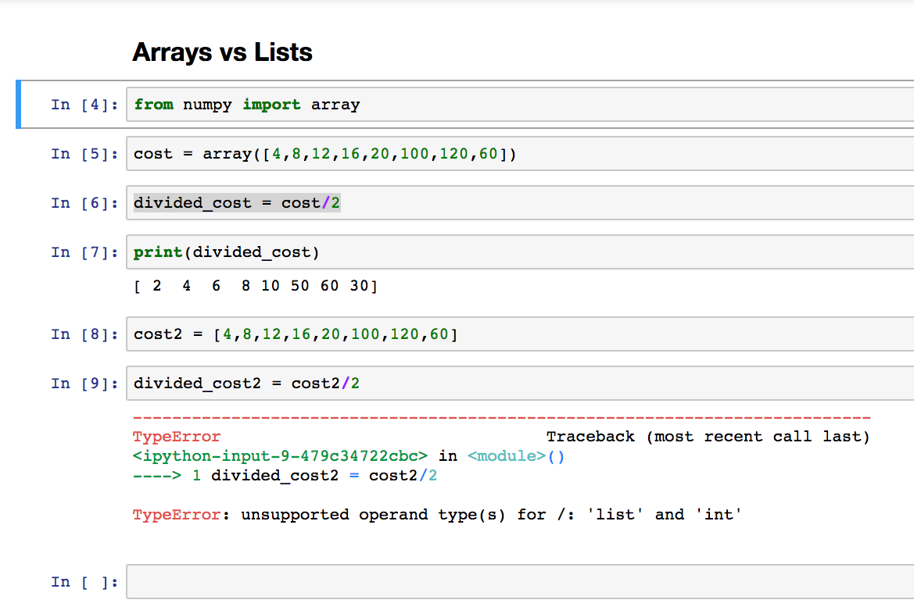
Lists/Arrays
Notes:
An array is like a following storage for many or multiple objects with the same type. To store a value in an array, use an index. Lists are like an interface, part of a package. Based on how you want to do it, it lets you define a type. Lists help hold objects in order. An arraylist uses the list interface to implement the array.

Slide 9
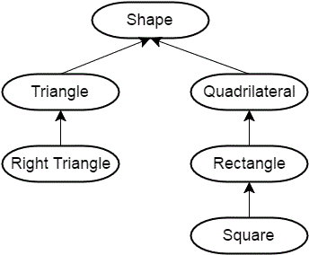
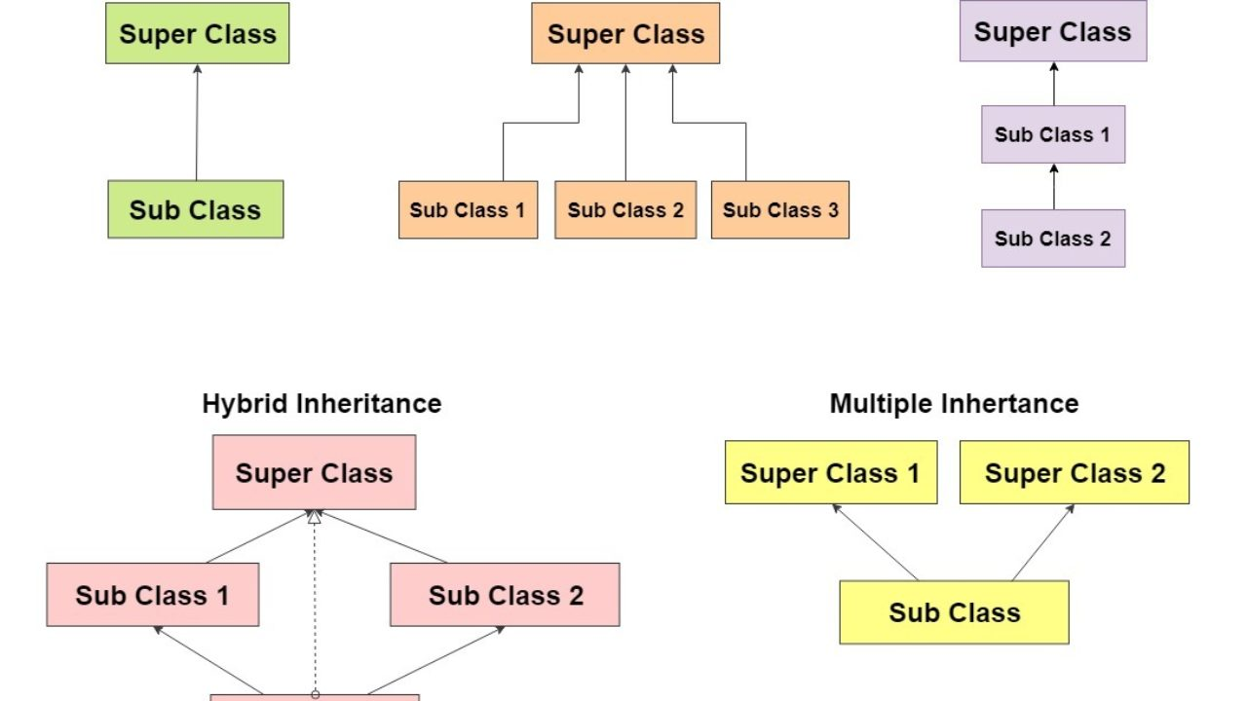
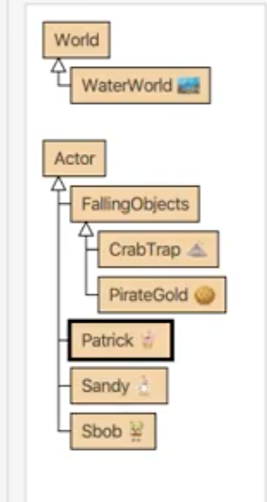
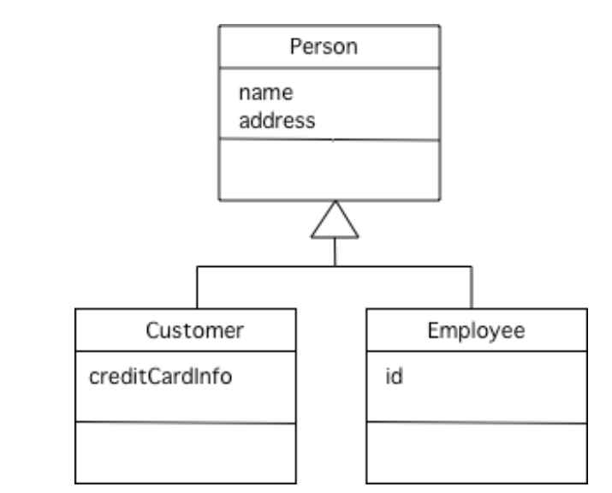
Inheritance
Notes:
Inheritance in java is where one object acquires all the properties and behaviors of a parent object. This way, it connects with the child or subclasses to the class or the parent class. By this, it keeps the code more organized and easier to handle since many things can be under one class. For example, for the previous project we worked on with sbob, you can see on the picture to the right, we used inheritance by having the crabtrab and pirate gold underneath falling objects. With this we could just code for both of the falling objects just in the falling objects class.

